Slide 1
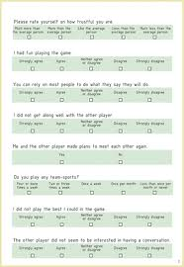
8. Developing Questions and Designing the Questionnaire
Frank Lin

Slide 2
To do:
Level of measurement quiz
Qualtrics HW
PA4

Slide 3
Data Collection Method
Surveys
Understand two critical aspects of Surveys
How to design the questionnaire
Questions
Responses
In today’s class we will focus on Questions

Slide 4
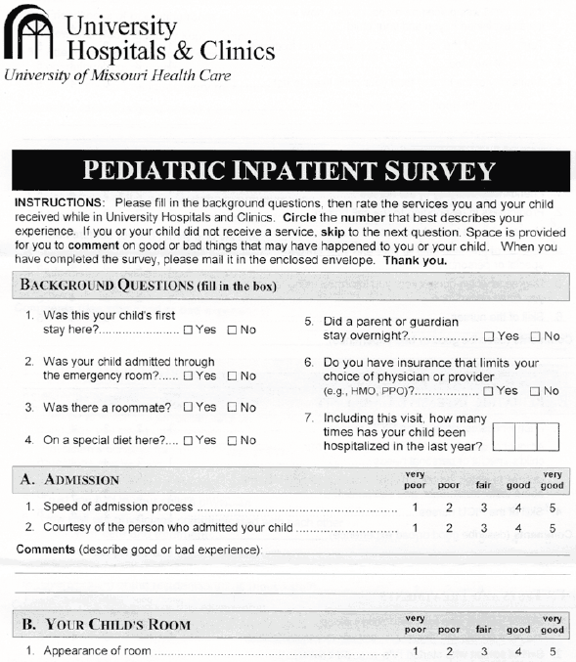
What is a Questionnaire?
A questionnaire is the vehicle used to pose the questions that the researcher wants respondents to answer
Example:
Nike shoes survey
Whirlpool survey
USPS survey

Slide 5
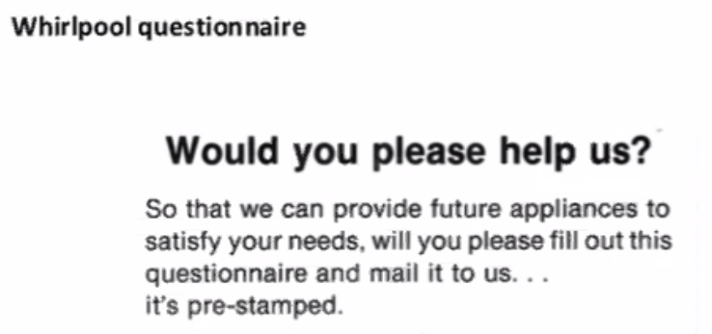

Slide 6
Questionnaire Design
Questionnaire design is a systematic process in which the researcher contemplates various question formats, considers a number of factors characterizing the survey at hand, ultimately words the various questions very carefully, and organizes the questionnaire’s layout
🡪 How to most effectively ask the questions to the respondents

Slide 7
The Functions of a Questionnaire
Translates the research objectives into specific questions
Standardizes those questions and the response categories
Serves as permanent records of the research
Speed up the process of data analysis
Serve as the basis for reliability and validity measures

Slide 8
Points to Remember when Designing Questionnaire
Inability to answer
Is the respondent informed?
What is the monthly expenses for groceries in your household?
Can the respondent remember?
Please list all the departments from which you purchased merchandise on your most recent shopping trip to a department store
Can the respondent articulate?
Describe the atmosphere of the department store you could prefer to patronize

Slide 9
Points to Remember when Designing Questionnaire
Inability to answer
What happens if the respondent are unable to articulate their response?
They skip questions
What to do in such cases?
Provide alternative description of the atmosphere

Slide 10
Developing Questions
Question development is the practice of selecting appropriate response formats and wording questions so that they are understandable, unambiguous, and unbiased.

Slide 11
Developing Questions
Marketing research questions measure
Behaviors
Attitudes
Demographics
Psychographics
Reason

Slide 12
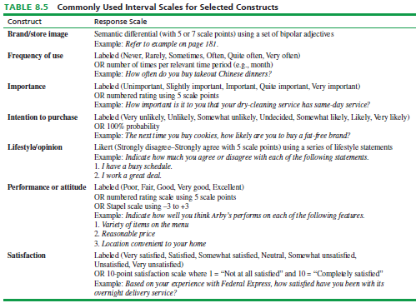

Slide 13
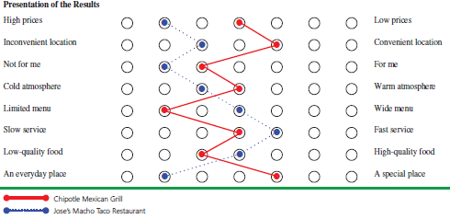

Slide 14
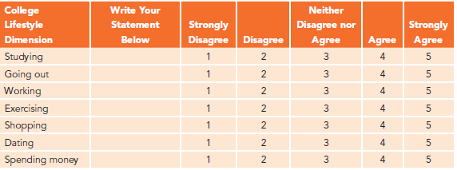
iClicker poll: Likert Scale statement
Write your statement for Going out, Exercising
Example for ‘Studying’: I am a studious person.
Notes:
College Life Style
Dimension
Your statement
Studying
I am a studious person.
Going out
I enjoy going out.
Working
I work to gain experience in my major.
Exercising
I exercise regularly
Shopping
Shopping is a large part of my life.
Dating
I usually go out on dates as much as the average student.
Spending money
I like to make purchases.

Slide 15
Identify the Issue
Which brand of bath soap do you use?
Evaluate the Question on W’s
The W’s | Defining the Question
Who | The Respondent
What | The brand of soap (What if more than one brand is used)
When | Is it Clear? (Time frame – Weeks/days, hour of the day)
Where | Home/Gym/On Road??
Which brand or brands of bath soap have you personally used at home during the past month? In case of more than one brand, please list all the brands that apply

Slide 16
Four “Do’s” of Questionnaire Wording
Focus on a single issue or topic.
“What type of hotel do you stay in on a trip?” Pleasure or business trip? En route or final destination?
Be Brief.
“What are the considerations that would come to mind to you while you are confronted with the decision to have some type of repair done on the icemaker in your refrigerator assuming that you noticed it was not making ice?”

Slide 17
Four “Do’s” of Questionnaire Wording
Grammatically Simple
Is the distribution of snack foods adequate? (Are snack foods readily available when you want to buy them?)
Clear and Unambiguous words
In a typical month, how often do you go to a movie theater to see a movie?
(Never, Occasionally, Sometimes, Often, Regularly)
OR
(Less than once, 1 or 2 times, 3 or 4 times, more than 4 times)

Slide 18
Usage of Appropriate Words
Words to Avoid
All
Always
Any
Anybody
Ever
Every
Never

Slide 19
Why to Avoid Such words
These words: all, any, anybody, best, ever, every, never, etc. are all EXTREME ABSOLUTES…
They place respondents in a situation where they must either fully agree or they must completely disagree with the extreme position in the question.
Do you always observe traffic signs?
1 Strongly disagree to 5 Strongly agree?

Slide 20
Four “Do Not’s” of Questionnaire Wording
“Lead” the respondent to a particular answer.
“Don’t you see any problem with using credit cards for online purchases?”
“Don’t you agree?”
“Loaded” wording or phrasing.
“Since our Founding Fathers gave us the right to bear arms…”
“Should we increase tax in order to get more housing and better schools, or should we keep them about the same?”

Slide 21
Four “Do Not’s” of Questionnaire Wording
“Double-barreled”
“Are you satisfied with the cost and convenience of this service?”
Words that overstate the condition…do not use “dramatics.”
“Would you buy sunglasses that protect your eyes from harmful ultraviolent rays that cause blindness?”

Slide 22
Iclicker short answer – Assess Do’s and Do Not’s of each Question
How Do you feel about Sears?
What’s wrong with the question?
When some gasoline or electric-powered product in your house breaks, do you call the Sears repair service?
What’s wrong with the question?
Notes:
Q1: Not focused on a single topic. Instead you can ask “ Please rate each aspect of Sears”
Q2: Long winded. Instead you can ask “When you need repair service, do you call Sears repair service?

Slide 23
In Class Exercise – Assess Do’s and Do Not’s of each Question
Shouldn’t concerned parents use car seats?
What’s wrong with the question?
Should car seats be used for our loved ones?
What’s wrong with the question?
Notes:
Don’t ask leading question. Instead you can ask “Do you think infant car seats are useful?”
Don’t ask loaded questions. Instead you can ask “Do you think car seats are useful for family members?”

Slide 24
In Class Exercise – Assess Do’s and Do Not’s of each Question
Are you satisfied with the price and quality of Graco car seats?
What’s wrong with the question?
Do you believe infant car sears can protect riders from being maimed?
What’s wrong with the question?
Notes:
Don’t ask double barreled question. Instead you can ask “Are you satisfied with the quality of Graco car seats?”
Don’t overstate questions. Instead you can ask “Do you think children’s car seats are useful?”

Slide 25
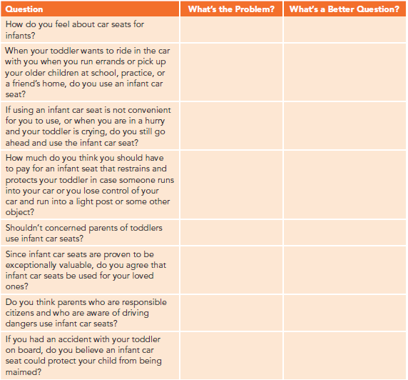

Slide 26
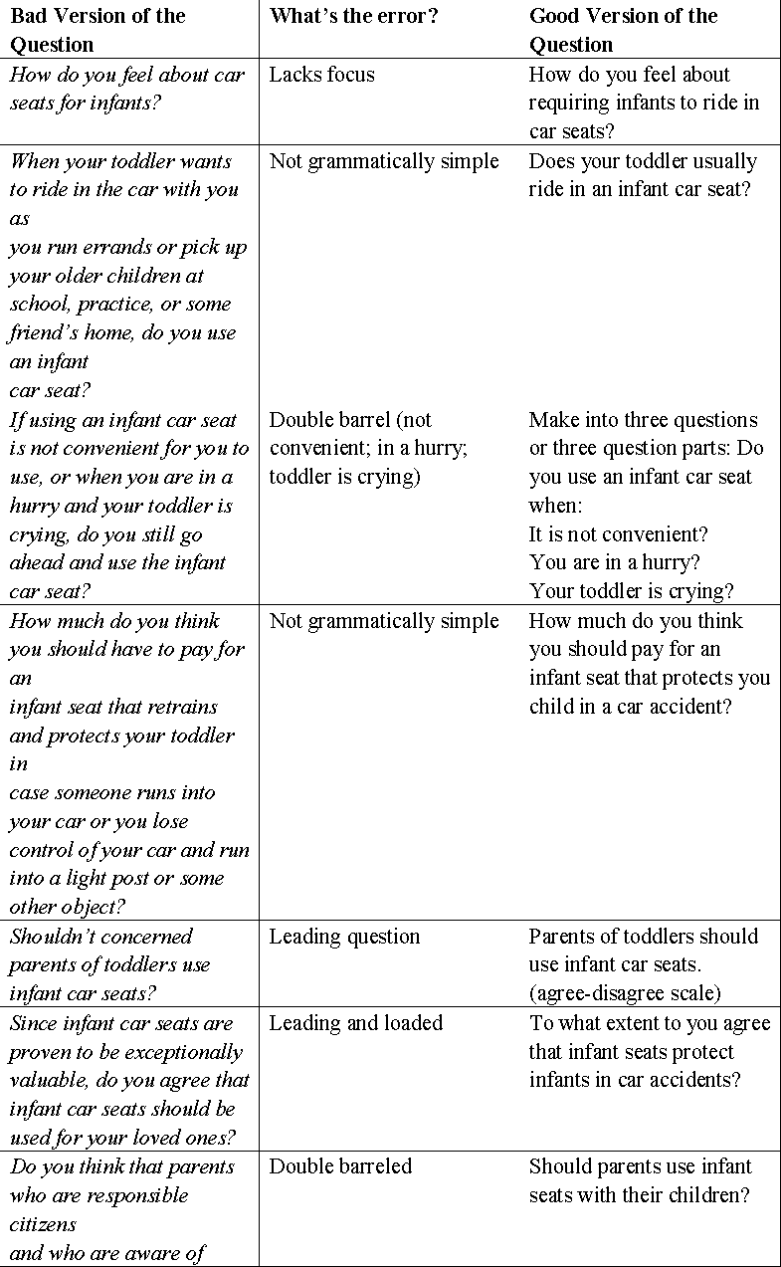

Slide 27
Questionnaire Organization
Questionnaire organization is the sequence of statements and questions that make up the questionnaire
It is important because the questionnaire appearance and ease of flow affect the quality of the information gathered.
The introduction is called a “cover letter” if the introduction is written to accompany a mail survey or online survey.

Slide 28
Questionnaire Organization
Five Functions
Identifies the survey or/sponsor
Indicates the purpose of the survey
Explains how the respondent was selected
Requests for/provides incentive for participation
Determines if respondent is suitable

Slide 29
Why some one should fill your Questionnaire
Incentives: offers to do something for the respondent to increase the probability that the respondent will participate in the survey
Incentives can be monetary or non-monetary
Money
Gifts
Product samples
“Chosen One”
Confidentiality

Slide 30
Reach the Right Respondent
Screening questions are used to ferret out respondents who do not meet research study qualifications.
Research objectives should specify who should and should not be included in the research study
Example: If you were conducting research on factors consumers use in selecting a new car, wouldn’t you only want to talk to persons who have recently selected a new car?

Slide 31
Question Flow in a Questionnaire
First Questions – Screens/Qualifiers
Have you shopped at Schnucks in the last month?
Immediately following screens - Warm-ups
How many major grocery shopping trips do you do in a month?
Transitions (statement or questions)
Now, I would like to ask you a few questions about ___.

Slide 32
Question Flow in a Questionnaire
Middle of questionnaire - Complicated & Difficult-to-Answer
Rate each of the following aspects of Schnucks on how satisfactory it is for you.
Last Section - Classification
What is the highest level of education you have earned?

Slide 33
Performing the Pre-Test of the Questionnaire
A pretest involves conducting a dry run of the survey on a small, representative set of respondents in order to reveal questionnaire errors before the survey is launched.
Always do this! It will save you time later!

Slide 34
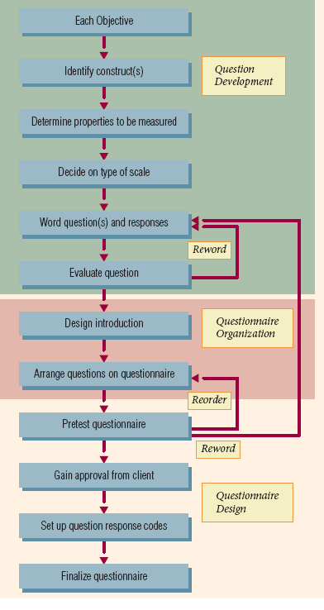
Steps in Questionnaire Design

